Slide 1


Instrument API and XML Method Modification Interface
ASMS Orbitrap Power User Meeting – June 2nd, 2018, San Diego, CA
Derek Bailey, Ph.D.
Notes:
Thank Shannon for spearheading
Thank attendees for coming

Slide 2
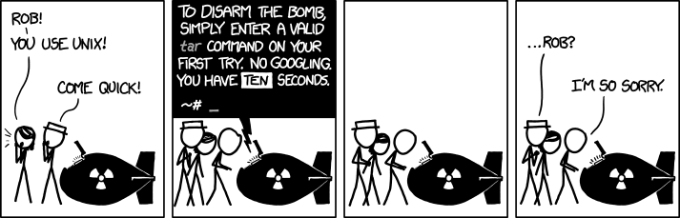
ASMS 2018 Warm Up Slide
https://xkcd.com/1168/
Notes:
Many slides over the next few days at ASMS so I’ll start with a warm up
With an obligatory XKCD comic
Once someone programs AI to search stackoverflow.com for answers, I’m out of a job…

Slide 3
Overview
Instrument Application Programming Interface (IAPI)
Real-time control and acquisition of Orbitrap Mass Spectrometers using .NET
XML Method Modification Interface (XMMI)
Programmatically modify Fusion-series method files
Applications of IAPI
Devin Schweppe – Fusion API
Christoph Wichmann – Q Exactive API
Examples and FAQ for IAPI and XMMI
Applications of XMMI
Pavel Shliaha – Fusion Method Creation
Notes:
Overview of the first half of today
Some special guest presenters on their experience using these tools

Slide 4
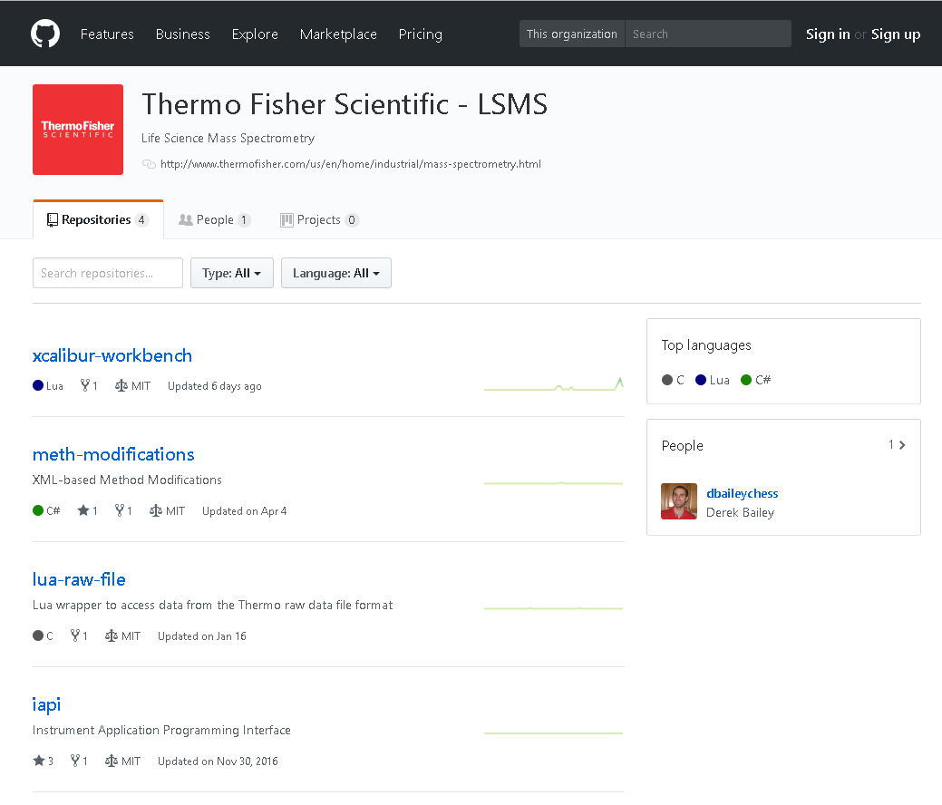
Thermo Fisher Scientific LSMS GitHub Page
https://github.com/thermofisherlsms
Notes:
All I will talk today will be on our github page

Slide 5
Thermo Fisher Scientific LSMS GitHub Page
https://github.com/thermofisherlsms
Mike Senko
Tuesday Poster
Covered Today
Covered Today
Notes:
Please see Mike’s poster on Tuesday about programmable-xcalibur
I’ll cover these two repositories in today’s talk

Slide 6
Overview
Instrument Application Programming Interface (IAPI)
Real-time control and acquisition of Orbitrap Mass Spectrometers using .NET
XML Method Modification Interface (XMMI)
Programmatically modify Fusion-series method files
Applications of IAPI
Devin Schweppe – Fusion API
Christoph Wichmann – Q Exactive API
Examples and FAQ for IAPI and XMMI
Applications of XMMI
Pavel Shliaha – Fusion Method Creation
Notes:
First I am going to give a brief overview of the IAPI and its capabilities

Slide 7
Why an API?
“Can I do this in method editor?”
“I wish I could do …”
“I only want to select peaks that have odd masses …”
“I have this awesome new experiment …”
Notes:
Why an API?
Lots of questions about doing cool things without mass spectrometers

Slide 8
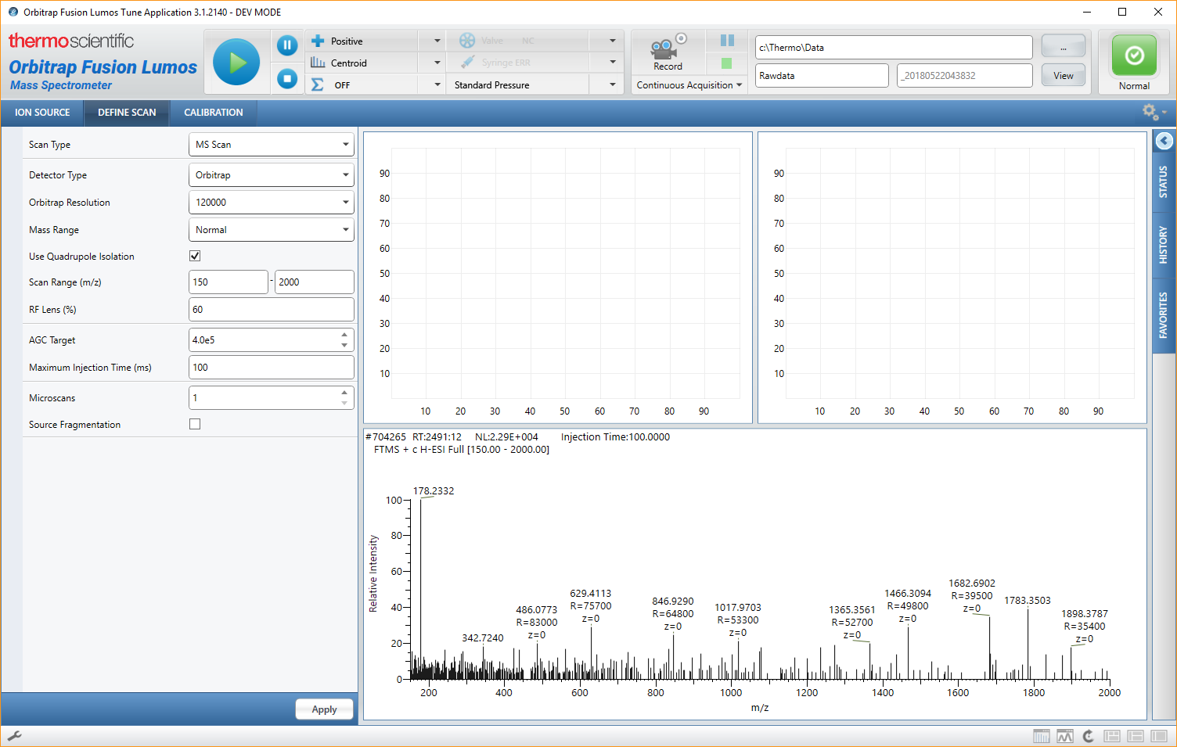
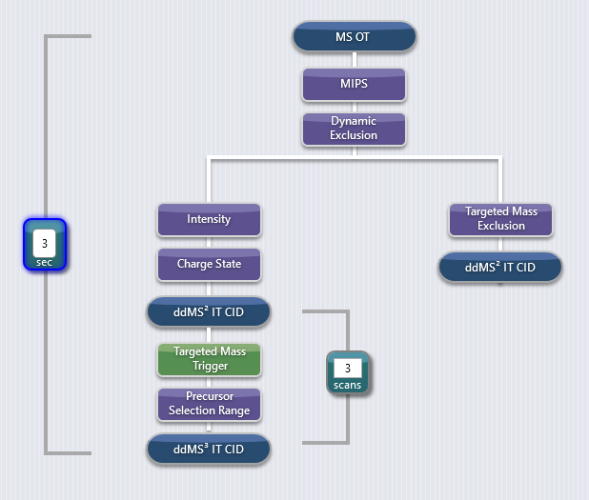
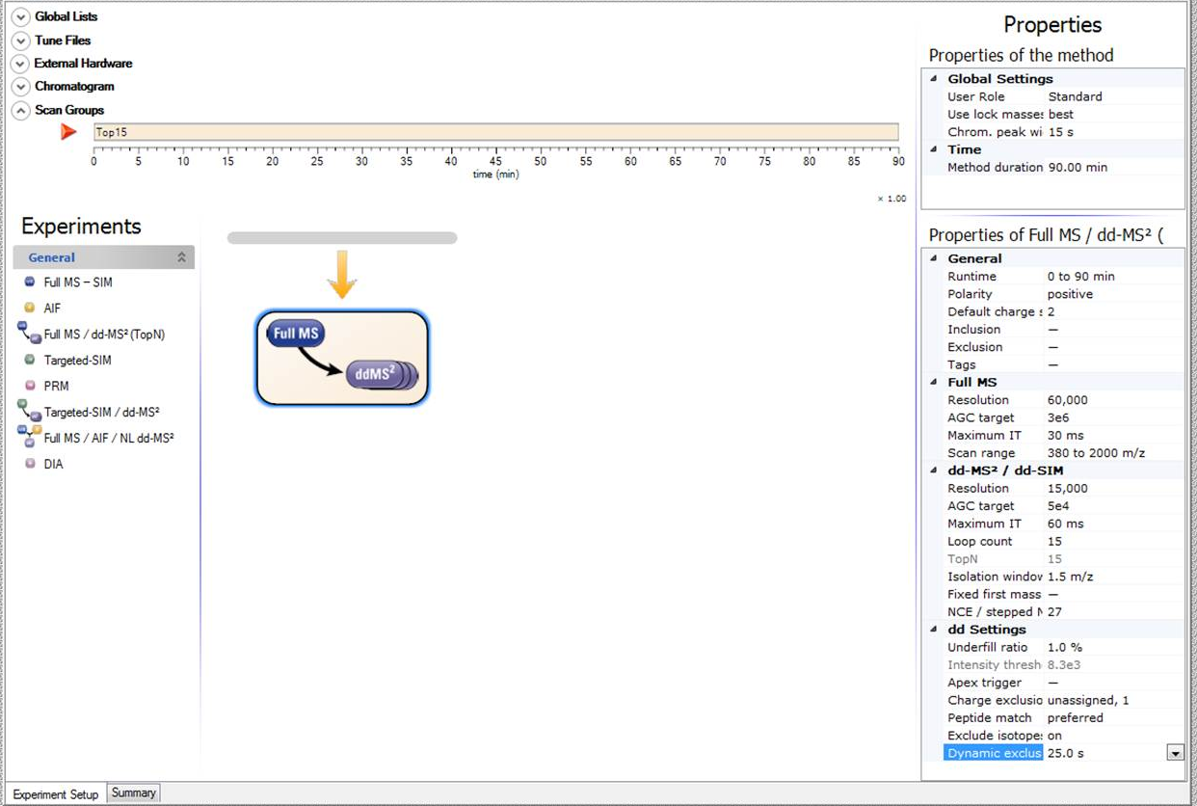
Why an API?
“Can I do this in method editor?”
“I wish I could do …”
“I only want to select peaks that have odd masses …”
“I have this awesome new experiment …”
Users can only control the Mass Spectrometer through our Tune application and Method acquisition.
Although both provide great flexibility in acquisition strategies they don’t encompass all possibilities.
Providing an Application Programming Interface enables users to extend the capabilities of the Orbitrap mass spectrometers.
Allows real-time data acquisition and control.
Notes:
We provide both Tune and Method Editor to allow flexibility, but not everything is possible
By providing an API, we can extend the capabilities of the MS
It also allows real-time control of the MS

Slide 9
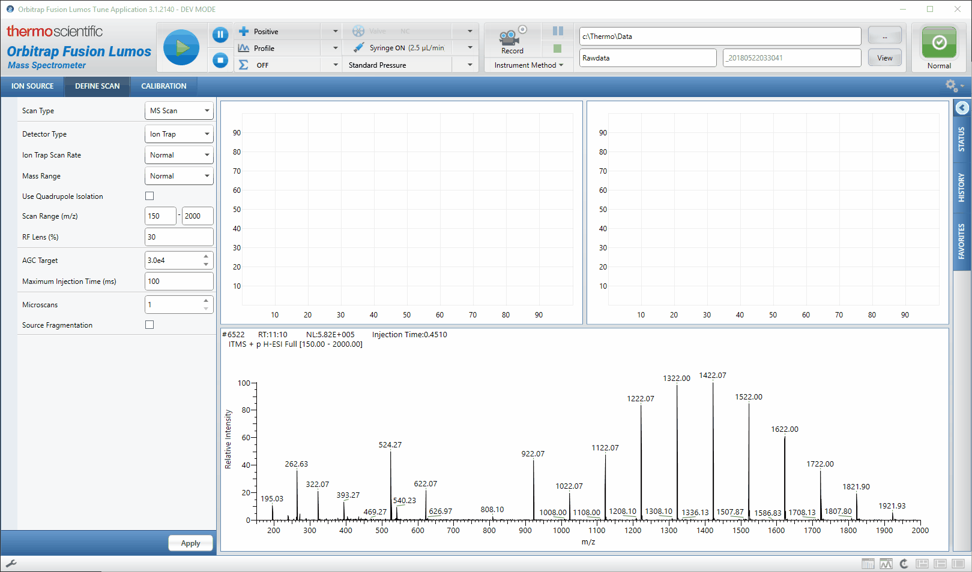
The IAPI empowers users to programmatically control acquisition
of both the Exactive and Tribrid-series Mass Spectrometers
Notes:
Here is just a quick demo of using a simple IAPI-enabled app to control the MS

Slide 10
IAPI Outline
IAPI Architecture
Interfaces
Data and Control Flow
Receiving Data from the MS
Interfaces
Scan Data Stream Subscription
Controlling the MS
Sending Scan Definitions
Changing other MS parameters
Getting Started
Notes:
Going to cover the following in the first talk
Will go over more examples, code, and questions in part 2

Slide 11
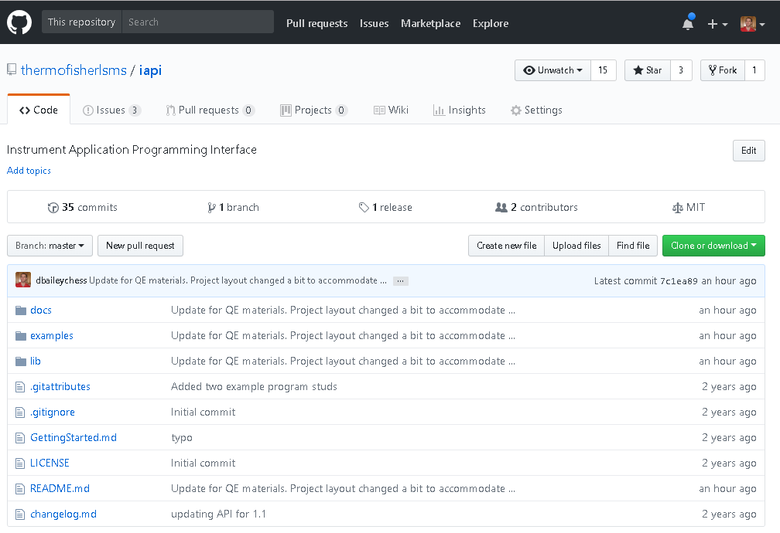
Instrument API Git Repository
https://github.com/thermofisherlsms/iapi
Public interfaces for
Tribrid
Exactive
Documentation
Previous ASMS Posters
Help files
VS Solution of Example Applications
External Requirements
Tune Installation
.NET 4.6.2+
License Agreement in place
IAPI License Key Activated
Notes:
Again, the IAPI is hosted on our GitHub page
It contains all the interfaces and documentation to get started
You’ll need a few things to use it

Slide 12
IAPI Outline
IAPI Architecture
Interfaces
Data and Control Flow
Receiving Data from the MS
Interfaces
Scan Data Stream Subscription
Controlling the MS
Sending Scan Definitions
Changing other MS parameters
Getting Started
Notes:
I’ll cover the overall architecture of the API

Slide 13
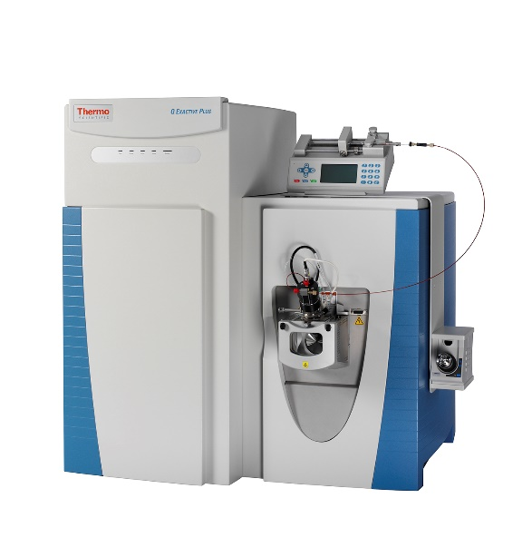
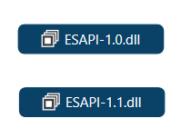
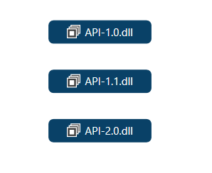

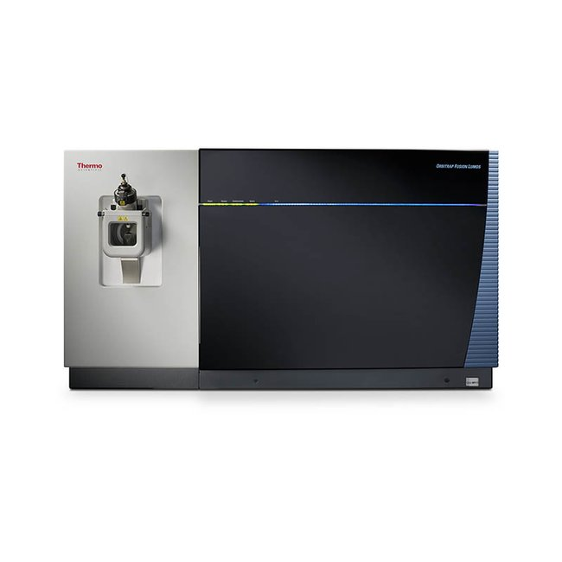
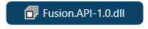
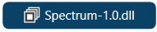

Interfaces
Exactive Series
IAPI Version
Instrument Extensions
Misc.
Tribrid Series
All interfaces are in the git repository, in the lib/ directory
Notes:
We have two IAPI-enabled instruments lines
The Exactive series came first with the first API definitions
It is broken into multiple assemblies.
The Tribrid series came next, with a newer API definition
Here again, we have the extensions for the Fusion API

Slide 14
Differences and Similarities between Exactive and Tribrid Series IAPI
Although IAPI 1.X is not binary compatible with IAPI 2.X, they share considerable amount of structure
Namespaces and hierarchies are virtually unchanged
A few name changes or minor reorganization
Removal of some interfaces
Spectrum-related interfaces moved into own assembly
Notes:
I would like to highlight some of the differences between the exactive and tribrid APIs

Slide 15
Differences and Similarities between Exactive and Tribrid Series IAPI
Although IAPI 1.X is not binary compatible with IAPI 2.X, they share considerable amount of structure
Namespaces and hierarchies are virtually unchanged
A few name changes or minor reorganization
Removal of some interfaces
Spectrum-related interfaces moved into own assembly
The logical flow for both receiving scan data and sending scans definitions to the instrument is identical
Notes:
I would like to highlight some of the differences between the exactive and tribrid APIs

Slide 16
Differences and Similarities between Exactive and Tribrid Series IAPI
Although IAPI 1.X is not binary compatible with IAPI 2.X, they share considerable amount of structure
Namespaces and hierarchies are virtually unchanged
A few name changes or minor reorganization
Removal of some interfaces
Spectrum-related interfaces moved into own assembly
The logical flow for both receiving scan data and sending scans definitions to the instrument is identical
Different methods for instantiating the IAPIs
Tribrid-series uses a Factory method model with Microsoft’s Managed Extensibility Framework (MEF)
Exactive-series uses the System.Reflection.Assembly API
Notes:
I would like to highlight some of the differences between the exactive and tribrid APIs

Slide 17
Differences and Similarities between Exactive and Tribrid Series IAPI
Although IAPI 1.X is not binary compatible with IAPI 2.X, they share considerable amount of structure
Namespaces and hierarchies are virtually unchanged
A few name changes or minor reorganization
Removal of some interfaces
Spectrum-related interfaces moved into own assembly
The logical flow for both receiving scan data and sending scans definitions to the instrument is identical
Different methods for instantiating the IAPIs
Tribrid-series uses a Factory method model with Microsoft’s Managed Extensibility Framework (MEF)
Exactive-series uses the System.Reflection.Assembly API
Some interfaces are not implemented due to technical reasons or deemed not immediately useful
Notes:
I would like to highlight some of the differences between the exactive and tribrid APIs

Slide 18
The rest of this presentation will focus on the Tribrid-series IAPI.
Most topics are applicable to the Exactive-series with minor differences.

Slide 19
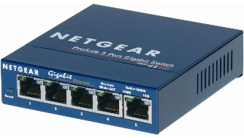


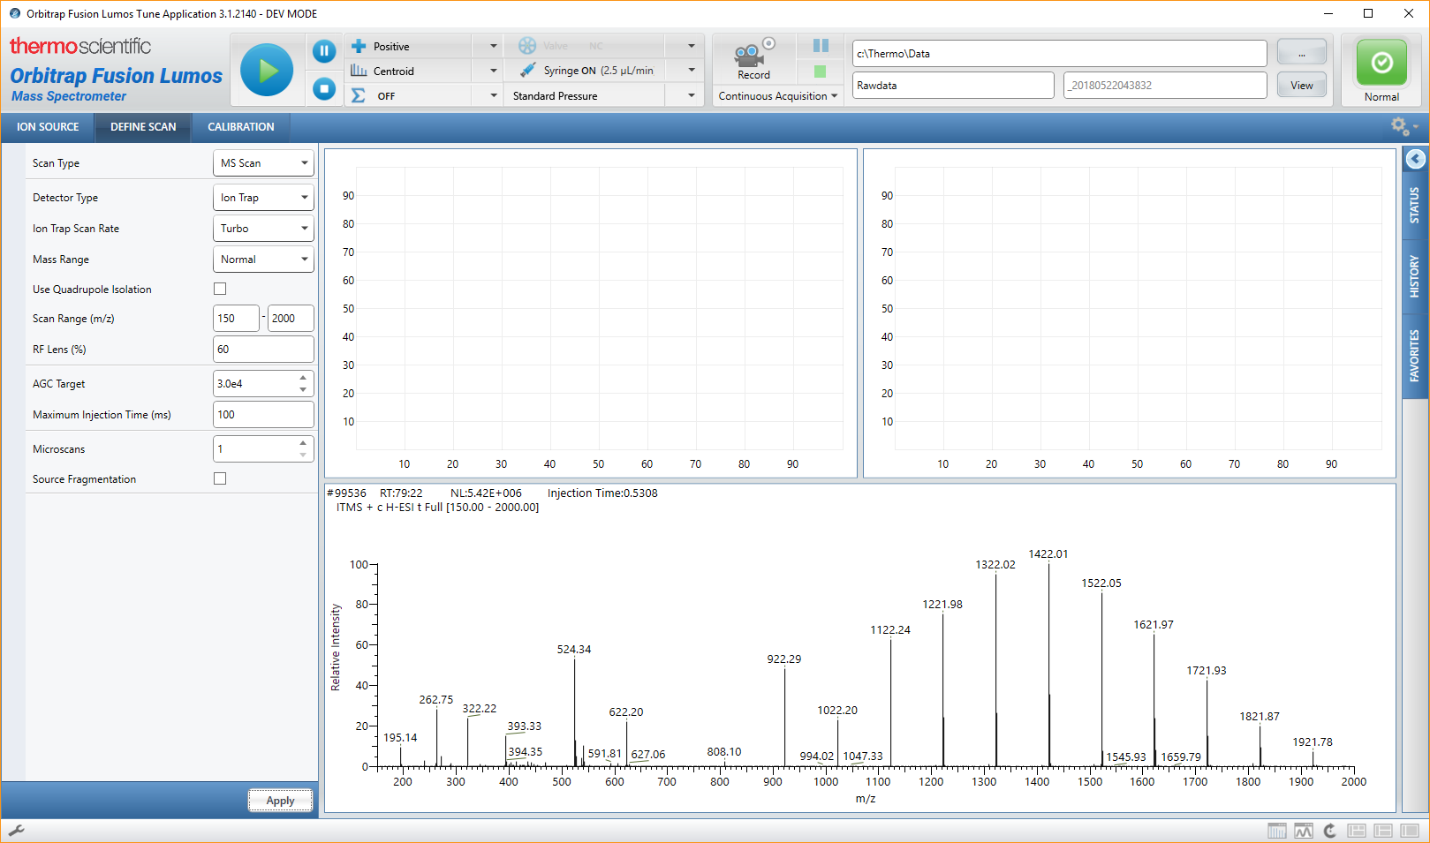
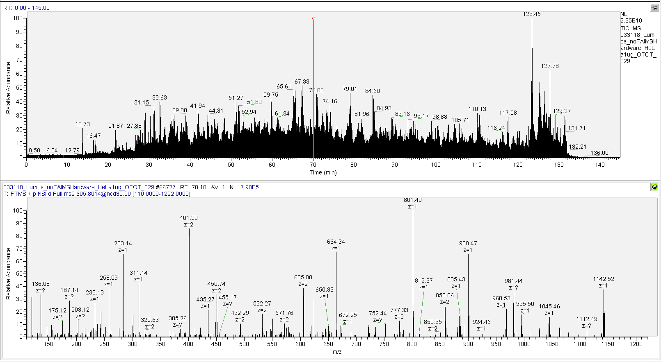
MS Architecture
Mass Spectrometer
Local Switch
Data System
Instrument
Service
Tune Application
Rawfile
Notes:
Here is the basic lay out of the MS architecture

Slide 20
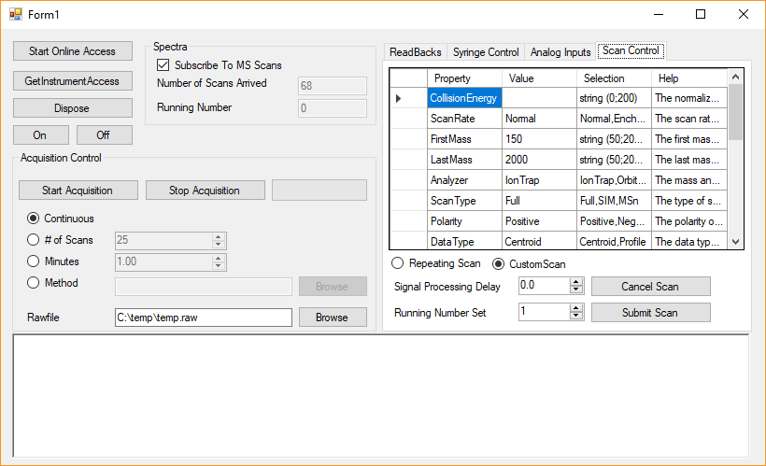

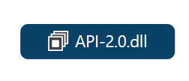
IAPI Architecture
Mass Spectrometer
Local Switch
Data System
IAPI-Enabled App
Instrument
Service
3rd Party
Application
Tune Application
Rawfile

Slide 21
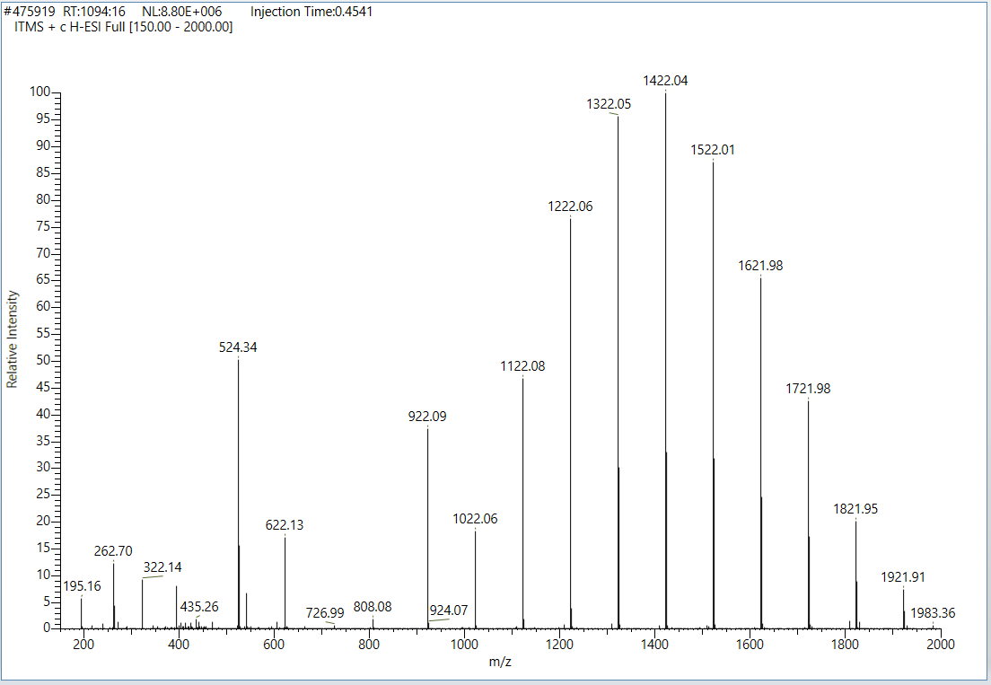
IAPI Data and Control Flow
Mass Spectrometer
Data System
Instrument
Service
3rd Party
Application
Displays scan in Tune
Writes to Rawfile
Forwards data to API
Converts data into IAPI format
Raises Event to any subscribers
Handles scan Event
Processes the data
Do whatever you want!
Scan Data
Stream
Notes:
If we start with the data flow of the spectrum through the service and API to the third party application

Slide 22
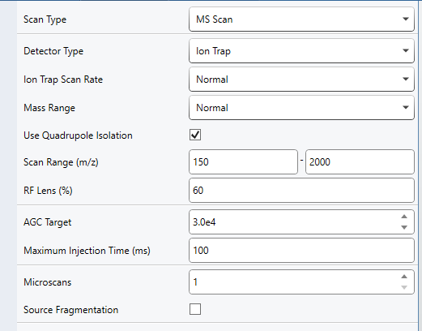
IAPI Data and Control Flow
Mass Spectrometer
Data System
Instrument
Service
3rd Party
Application
Displays scan in Tune
Writes to Rawfile
Forwards data to API
Converts data into IAPI format
Raises Event to any subscribers
Handles scan Event
Processes the data
Do whatever you want!
Scan Data
Stream
Logs event
Downloads scan definition to instrument
Validates scan definition
Forwards scan to Instrument Service
Calls IAPI to create IScanDefinition object
Changes definition as sees fit
Scan Definition
Notes:
We also allow the third party app to modify what the instrument is doing

Slide 23
IAPI Outline
IAPI Architecture
Interfaces
Data and Control Flow
Receiving Data from the MS
Interfaces
Scan Data Stream Subscription
Controlling the MS
Sending Scan Definitions
Changing other MS parameters
Getting Started
Notes:
Lets dig in deeper into the receiving side of things

Slide 24
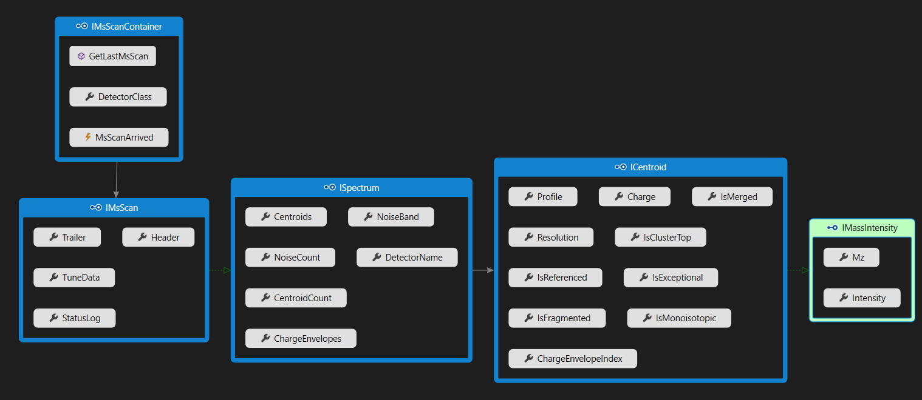
MS Scan Interfaces
IMsScanContainer exposes IMsScans
IMsScan contains metadata and derives from ISpectrum
ISpectrum contains a collection of ICentroids
ICentroids contains meta data and derives from IMassIntensity
IMassIntensity is the m/z and intensity data

Slide 25
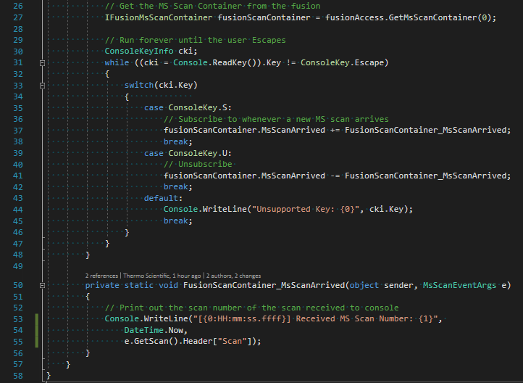
Scan Data Stream
Receiving the scan data is through the Event Driven programming model
Scans are sent via the .NET Event and EventHandler mechanism
Multiple handlers per scan can be registered
Minimal overhead and latency
Receives Scans from both Tune and Method acquisitions
This example is from the examples/tribrid/MinifiedExample/ directory in the Git repository

Slide 26
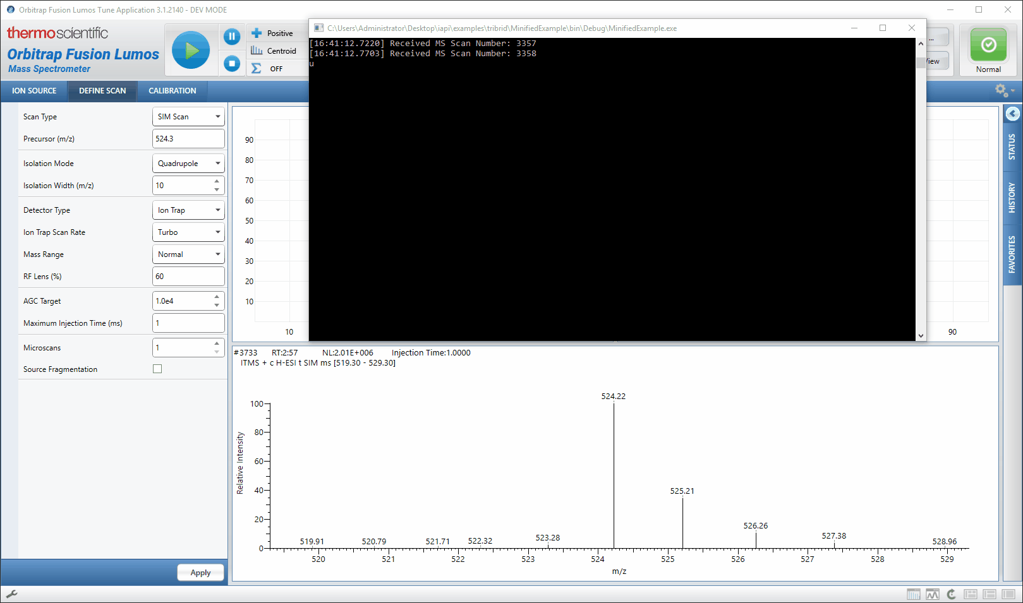
Scan Data Stream
Receiving the scan data is through the Event Driven programming model
Scans are sent via the .NET Event and EventHandler mechanism
Multiple handlers per scan can be registered
Minimal overhead and latency
Receives Scans from both Tune and Method acquisitions
tSIM running ~21 Hz (47.5 ms) from Tune.
Average time of 48.4 ms between scans received (n = 200)
This example is from the examples/tribrid/MinifiedExample/ directory in the Git repository

Slide 27
Scan Data Stream
Receiving the scan data is through the Event Driven programming model
Scans are sent via the .NET Event and EventHandler mechanism
Multiple handlers per scan can be registered
Minimal overhead and latency
Receives Scans from both Tune and Method acquisitions
tSIM running ~21 Hz (47.5 ms) from Tune.
Average time of 48.4 ms between scans received (n = 200)
The IAPI is responsive and has no impact on the MS acquisition
This example is from the examples/tribrid/MinifiedExample/ directory in the Git repository

Slide 28
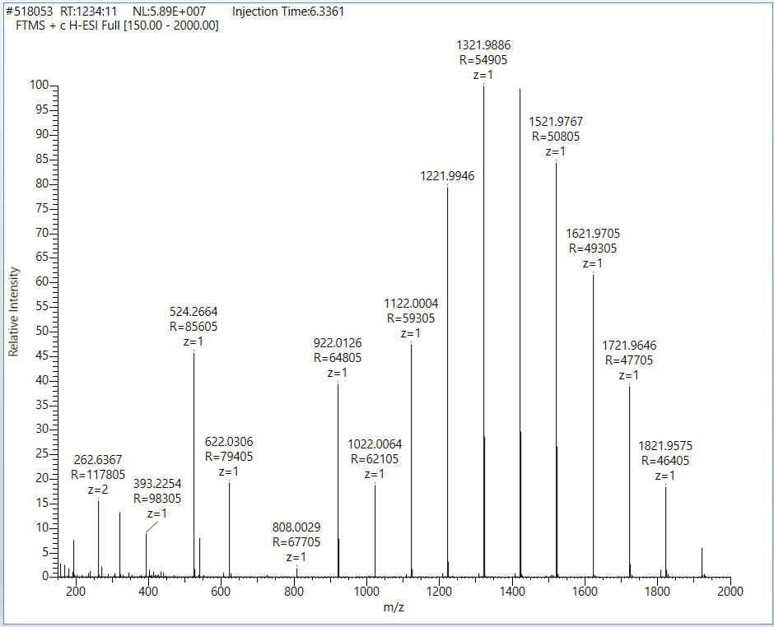
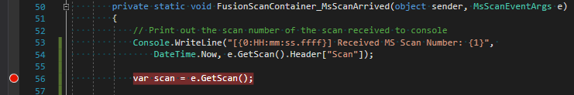
Scan Data Contents

Slide 29
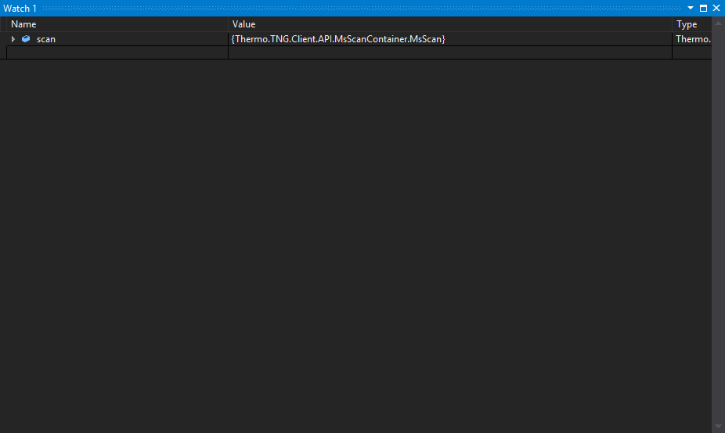
Scan Data Contents

Slide 30
IAPI Outline
IAPI Architecture
Interfaces
Data and Control Flow
Receiving Data from the MS
Interfaces
Scan Data Stream Subscription
Controlling the MS
Sending Scan Definitions
Changing other MS parameters
Getting Started

Slide 31
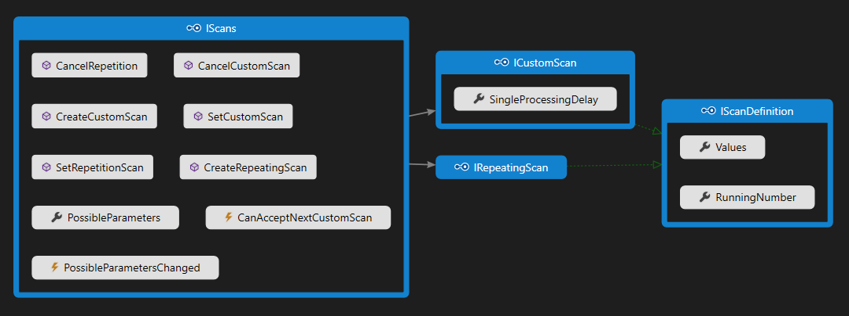
IScans Interface
Sending scans to the instrument is through the IScans interface
Provides methods for creating different types of IScanDefinitions
Provides methods for setting and cancelling scans.

Slide 32
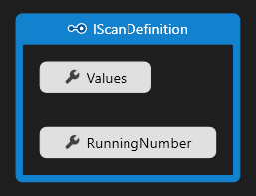
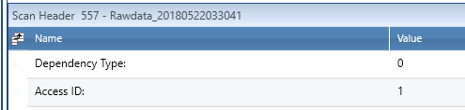
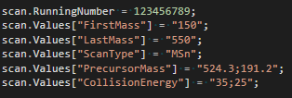
IScanDefinition
Scans are defined in the IScanDefinition interface
The RunningNumber property is for general purpose use
It shows up in the Scan Trailer as the ‘Access ID’ field
The Values property is a Dictionary<string,string>
Keys are the scan parameters
Values are their associated values
Values can take different formats based on the parameter
Invalid, or nonsense values, are ignored
Example of MS³ of 524@35 191@25
Scan 150 – 550 m/z

Slide 33
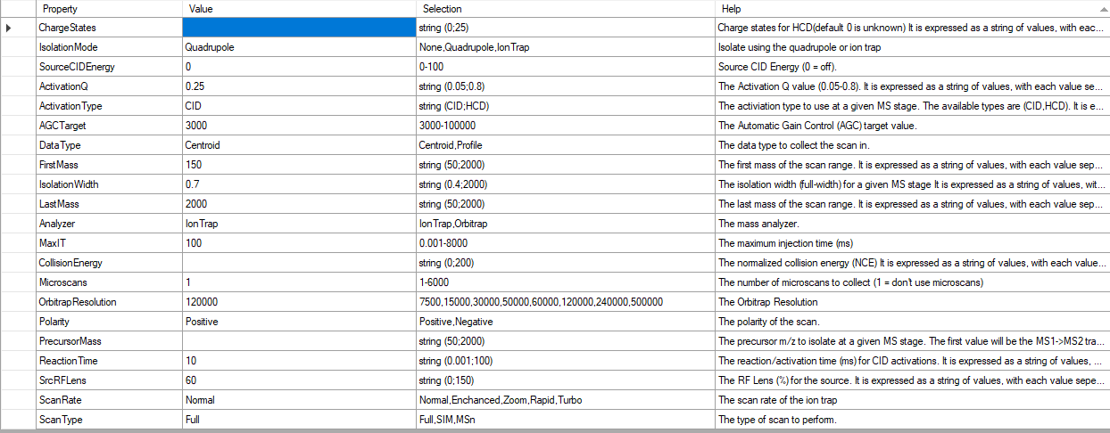
IScanDefinition

Slide 34
Scan Management
Mass Spectrometer
Local Switch
Data System
IAPI-Enabled App
Instrument
Service
3rd Party
Application
Sending Scan to MS

Slide 35
Scan Management
Mass Spectrometer
Local Switch
Data System
IAPI-Enabled App
Scan Hierarchy
Instrument
Service
3rd Party
Application
Custom
Repeating
Priority
Method
Tune
Sending Scan to MS

Slide 36
Scan Management
Scan Hierarchy
Custom
Repeating
Priority
Method
Tune

Slide 37
Scan Management - ICustomScan
Scan Hierarchy
Single scan, drops to lower level after completion
Custom
Repeating
Priority
Method
Tune

Slide 38
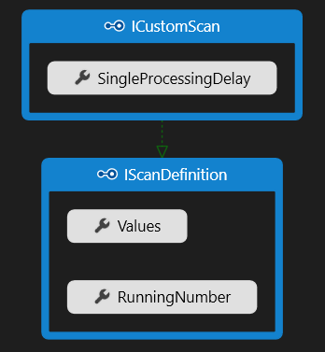
Scan Management - ICustomScan
Scan Hierarchy
Single scan, drops to lower level after completion
Custom
Repeating
Once executed, waits the Single Processing Delay (s) for a new Custom scan to arrive*
Default delay is 0 seconds (no waiting)
Immediately ends the wait if a new Custom scan arrives or there are pending ones
The Tribrid uses a circular buffer (40-capacity) to store them
Priority
Method
Tune
* Single Processing Delay is not enabled when occurring during Tribrid method acquisition, due to acquisition pipeline

Slide 39
Scan Management - IRepeatingScan
Scan Hierarchy
Custom
Repeats scan until explicitly canceled by user
Repeating
Priority
Method
Continually runs the same scan until:
Cancelled by the user
Replaced by a new Repeating Scan
Preempted by a Custom Scan
Tune

Slide 40
Scan Management - IRepeatingScan
Scan Hierarchy
Custom
Repeating
Priority
Runs Scans and logic defined in the method
Method
Tune
Runs the normal method logic until completion or new IAPI scan arrives

Slide 41
Scan Management - IRepeatingScan
Scan Hierarchy
Custom
Repeating
Priority
Method
Runs the Scan defined in Tune
Tune

Slide 42
Scan Management
Scan Hierarchy
Custom
Repeating
Priority
Method
Tune
Start Method
Time

Slide 43
Scan Management
Scan Hierarchy
Custom
Repeating
Priority
Method
Set Repeating
Tune
Start Method
Time

Slide 44
Scan Management
Scan Hierarchy
Custom
Repeating
Set Custom
Priority
Method
Set Repeating
Tune
Start Method
Time

Slide 45
Scan Management
Scan Hierarchy
Custom
Repeating
Set Custom
Priority
Canceled Repeating
Method
Set Repeating
Tune
Start Method
Time

Slide 46
Scan Management
Scan Hierarchy
Custom
Repeating
Set Custom
Priority
Canceled Repeating
Method
Set Repeating
Tune
Start Method
Time

Slide 47
Scan Management
Scan Hierarchy
Custom
Repeating
Set Custom
Priority
Canceled Repeating
Method
Set Repeating
Method Completed
Tune
Start Method
Time

Slide 48
Scan Management
Scan Hierarchy
Custom
Repeating
Set Custom
Priority
Canceled Repeating
Method
Set Repeating
Method Completed
Tune
Start Method
Time

Slide 49
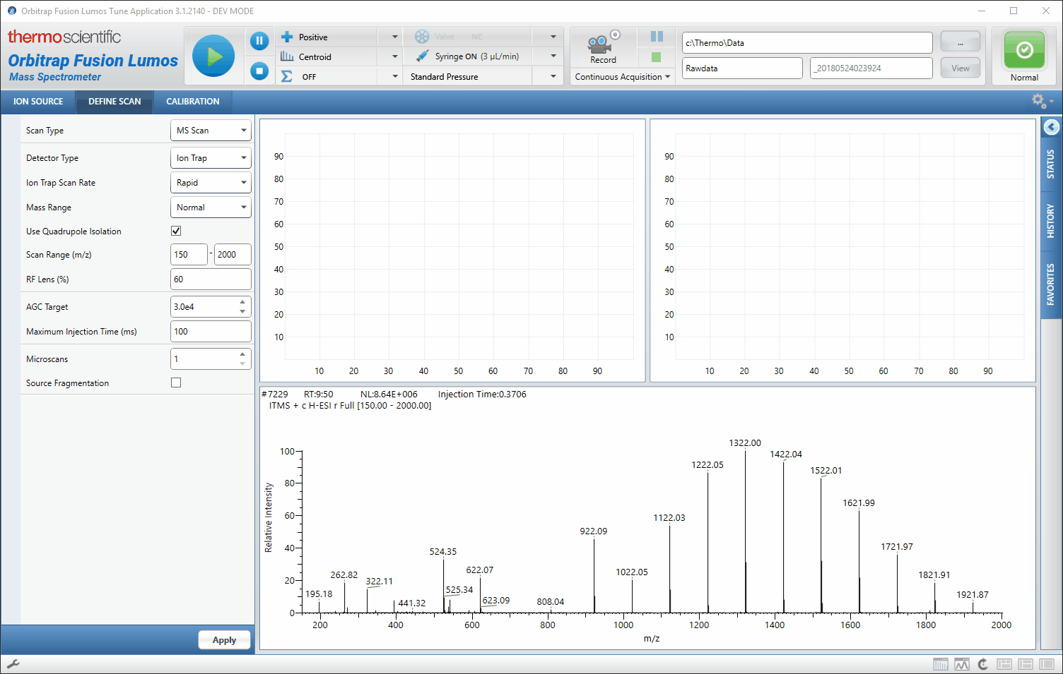
Scan Management
Scan Hierarchy
Custom
Repeating
Priority
Method
Tune

Slide 50
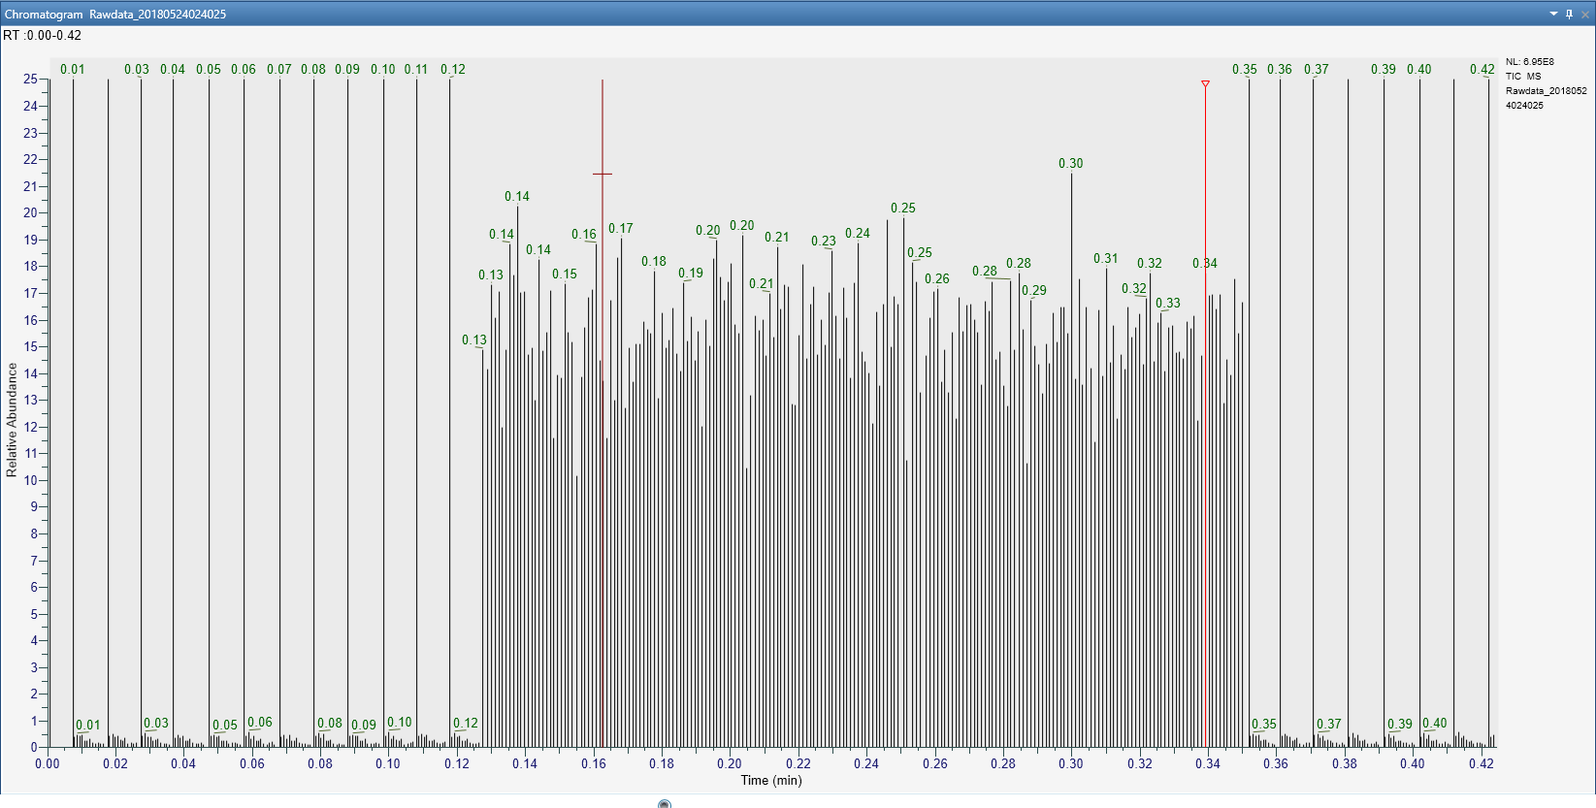
Scan Management
Scan Hierarchy
Custom
Repeating
Priority
Method
Tune
Method Scans
IAPI Scans
Method Scans

Slide 51
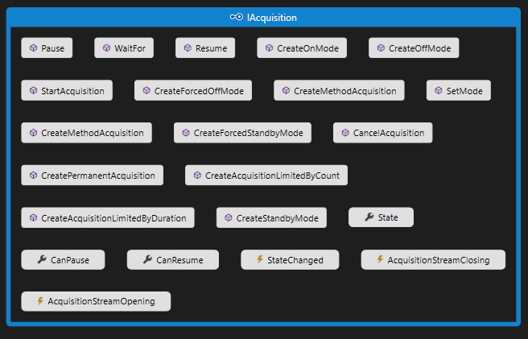
Starting Acquisitions from the IAPI
The IAcquisition interface enables the IAPI to start/stop acquisitions
It also has Events for listening to when an acquisition starts and stops

Slide 52
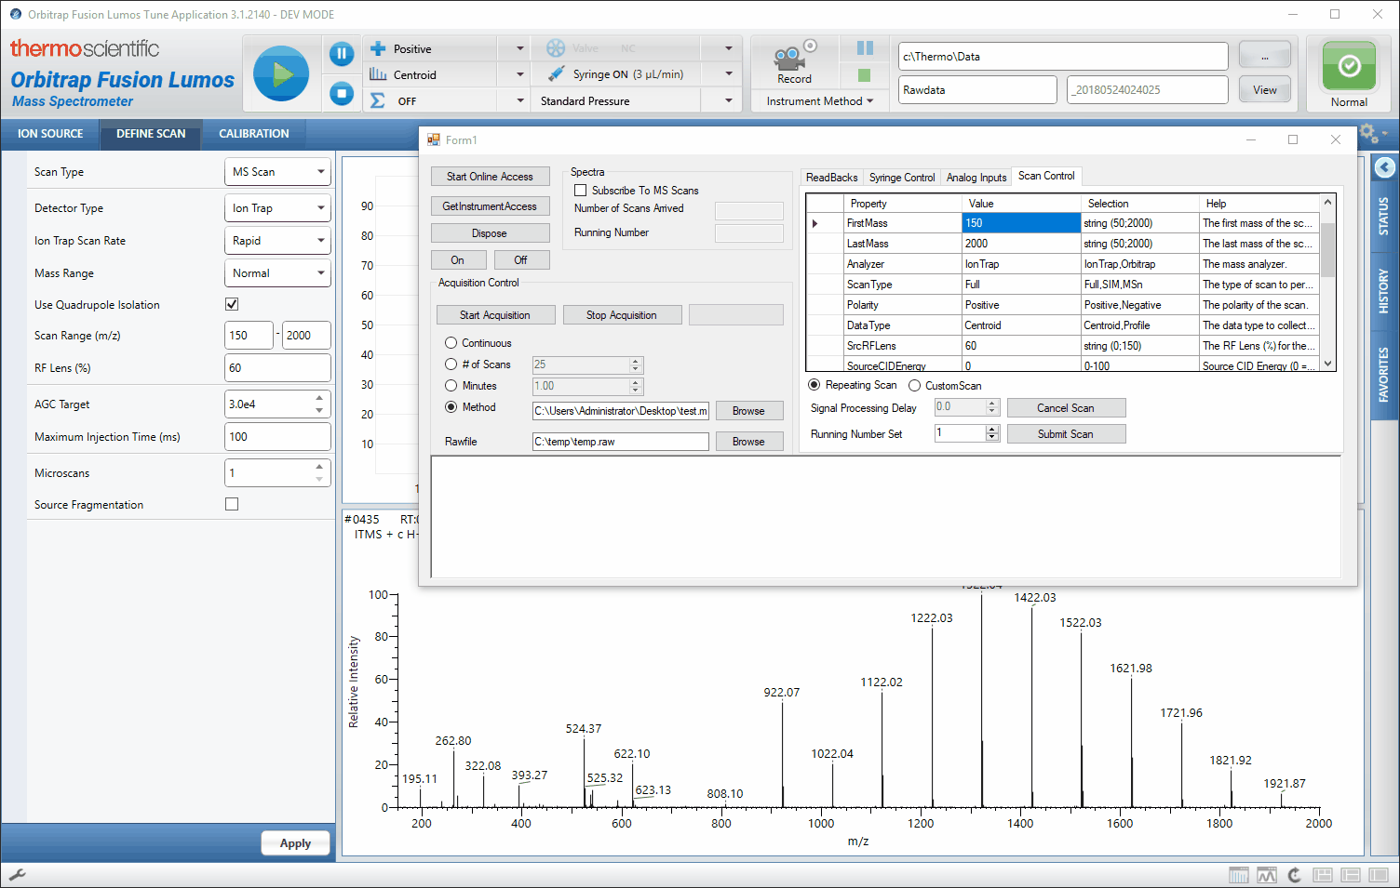
Starting Acquisitions from the IAPI
The IAcquisition interface enables the IAPI to start/stop acquisitions
It also has Events for listening to when an acquisition starts and stops

Slide 53
IAPI Outline
IAPI Architecture
Interfaces
Data and Control Flow
Receiving Data from the MS
Interfaces
Scan Data Stream Subscription
Controlling the MS
Sending Scan Definitions
Changing other MS parameters
Getting Started

Slide 54
License Activation
Access to the IAPI is given after a fully executed IAPI License is in force.
Contact ThermoMSLicensing@thermo.com to get started
Please include which IAPI (Tribrid or Exactive) you would like access to in your initial correspondence

Slide 55
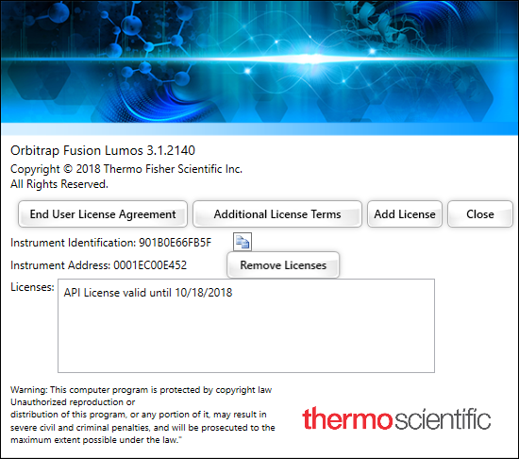
License Activation
Access to the IAPI is given after a fully executed IAPI License is in force.
Contact ThermoMSLicensing@thermo.com to get started
Please include which IAPI (Tribrid or Exactive) you would like access to in your initial correspondence
A license key will be provided to you and is entered in Tune’s “About Tune” dialog
Restart both the Instrument and Data system computer and the API will be enabled
Activating the License on the Tribrids

Slide 56
Overview
Instrument Application Programming Interface (IAPI)
Real-time control and acquisition of Orbitrap Mass Spectrometers using .NET
XML Method Modification Interface (XMMI)
Programmatically modify Fusion-series method files
Applications of IAPI
Devin Schweppe – Fusion API
Christoph Wichmann – Q Exactive API
Examples and FAQ for IAPI and XMMI
Applications of XMMI
Pavel Shliaha – Fusion Method Creation

Slide 57
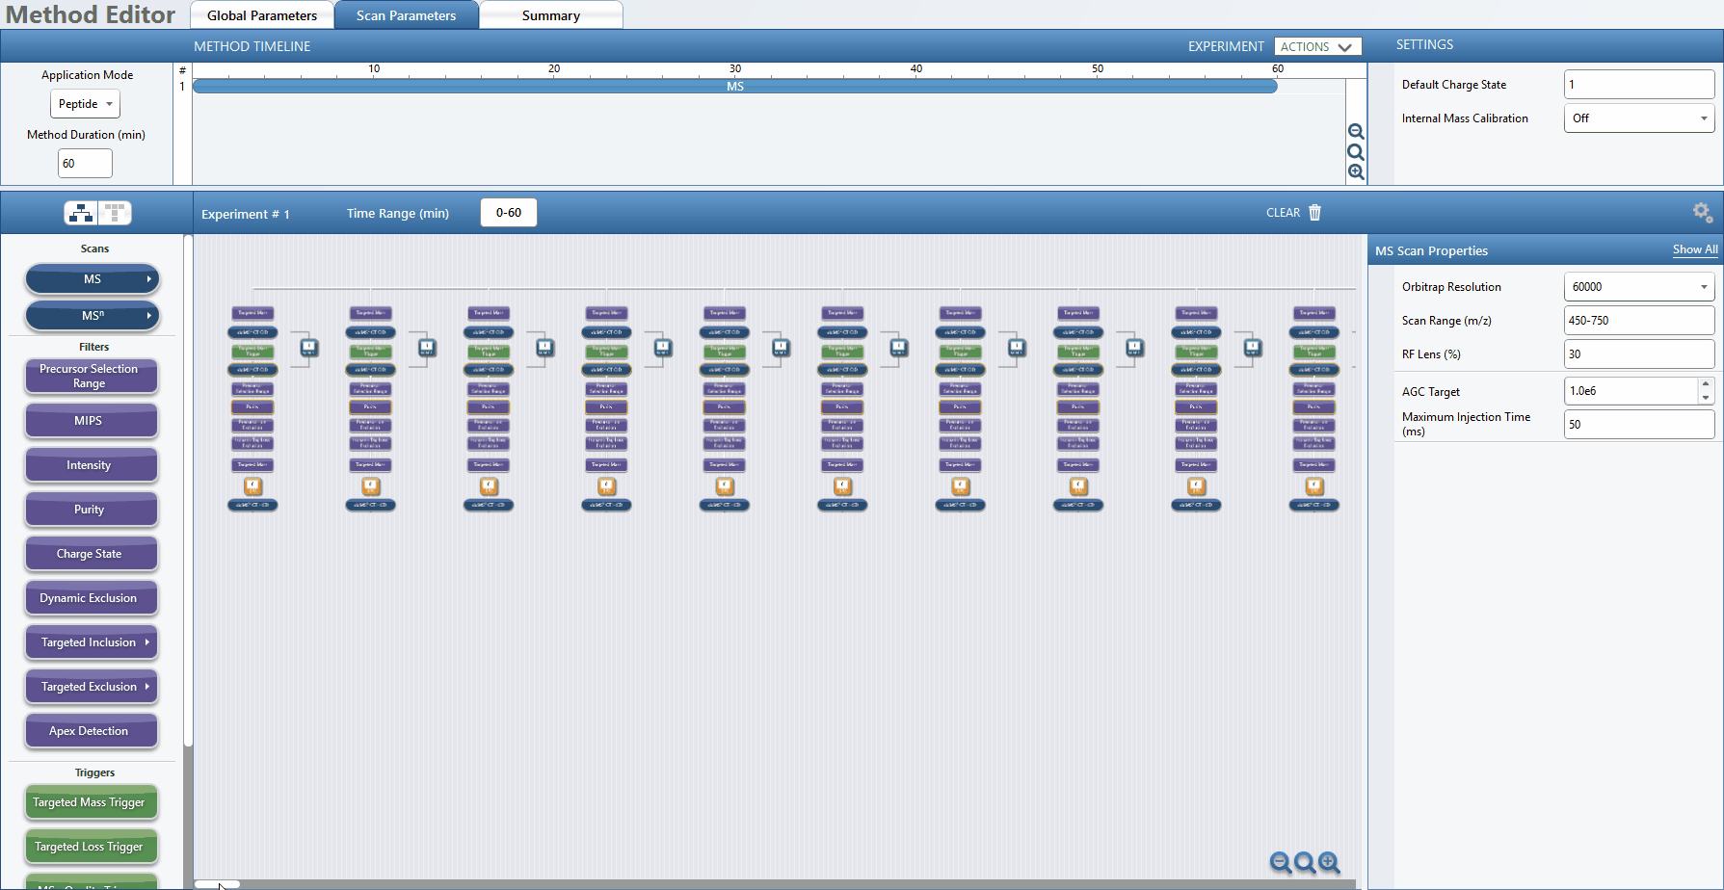
The Method Editor offers tremendous flexibility in method creation;
sometimes manually editing complex methods is laborious.
Method courtesy of Christopher Rose

Slide 58



Programmatically Modify Fusion Methods
Method File
XML Method
Modification Interface
Modified
Method File
Modifications

Slide 59
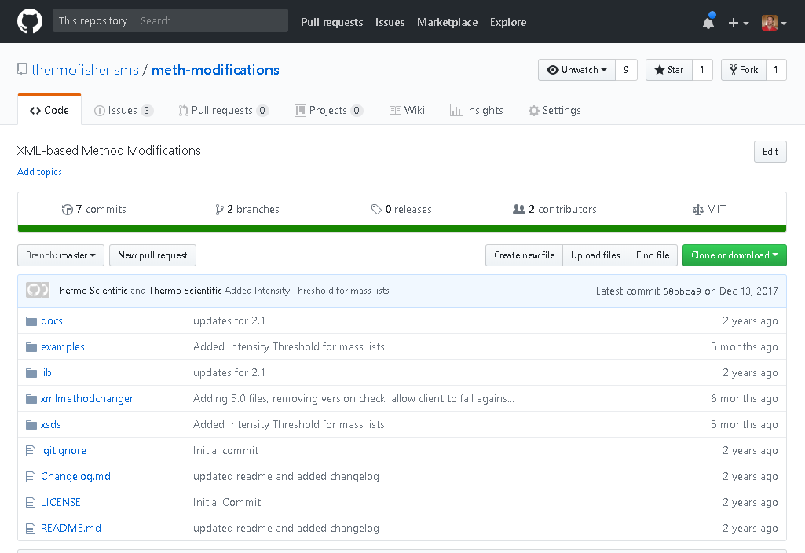
Method Modifications Git Repository
https://github.com/thermofisherlsms/meth-modifications
Supports Fusion and Triple-Quad Methods
Versions 1.2, 2.0, 2.1, 3.0 and 3.1
Documentation
Complete Examples
VS Solution
Command Line Program
Heavily commented code
Schemas
External Requirements
Tune Installation
Full or Workstation
.NET 4.6.2+

Slide 60
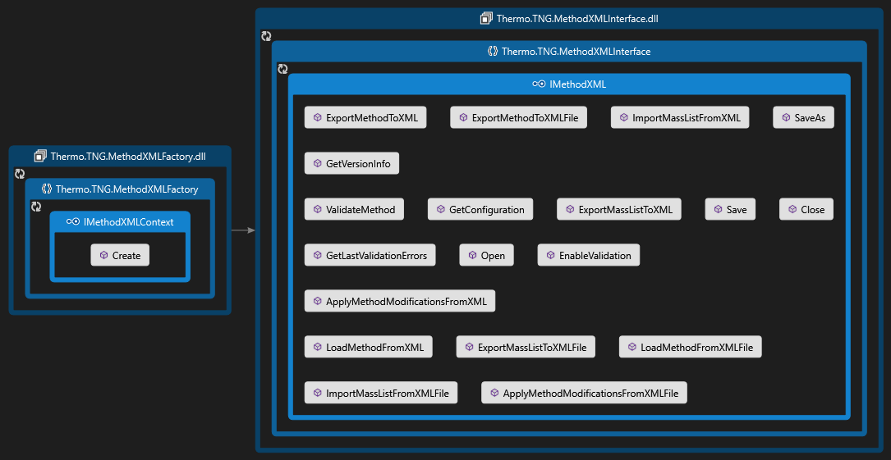
XML Modification Interfaces
Notes:
Two .NET assemblies are needed:
Thermo.TNG.MethodXMLFactory.dll
Thermo.TNG.MethodXMLInterface.dll

Slide 61
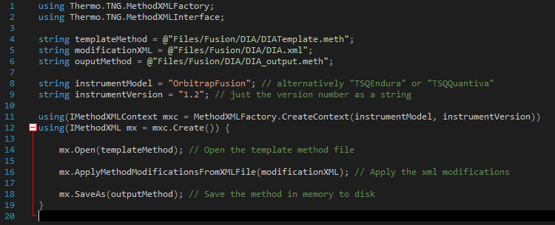
Complete Code Example

Slide 62
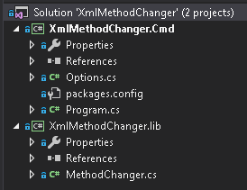
Method Modifications Visual Studio Solution
The XmlMethodChanger Solution contains two projects
XmlMethodChanger.lib
A public, static class library (MethodChanger)
Wraps the two Thermo.TNG.*.dll assemblies
Provides public methods for common tasks
Serves as an example of the API Usage
XmlMethodChanger.cmd
Command-line program that uses XmlMethodChanger.lib
Uses third-party NuGet package (Command Line Parser Library)
Can be used as a standalone tool for modifying methods

Slide 63
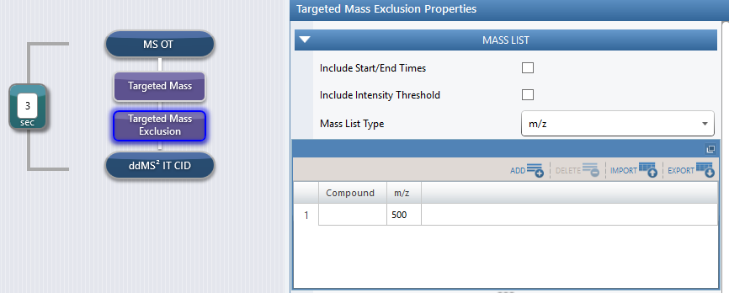
Demonstration
The “template” method contains the structure of the experiment
This example is from the examples/Fusion/IntensityThreshold/ directory in the Git repository

Slide 64
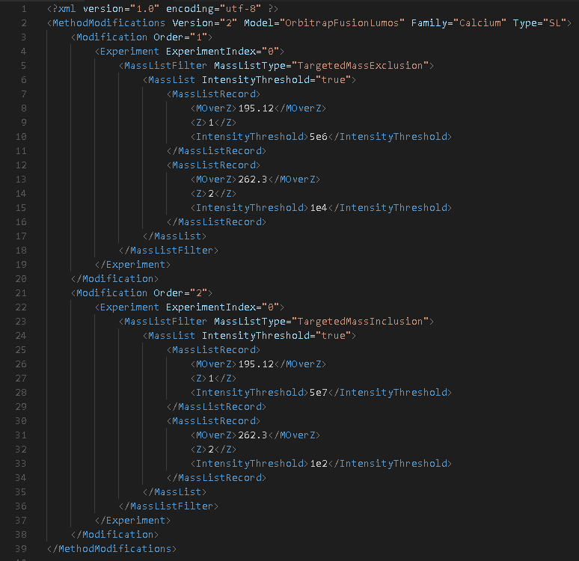
Demonstration
The “template” method contains the structure of the experiment
The modification XML specifies a list of transformations to perform on the “template” method file
This example is from the examples/Fusion/IntensityThreshold/ directory in the Git repository

Slide 65
Demonstration
The “template” method contains the structure of the experiment
The modification XML specifies a list of transformations to perform on the “template” method file
The transformed method can then be saved to a separate .meth file
This example is from the examples/Fusion/IntensityThreshold/ directory in the Git repository

Slide 66
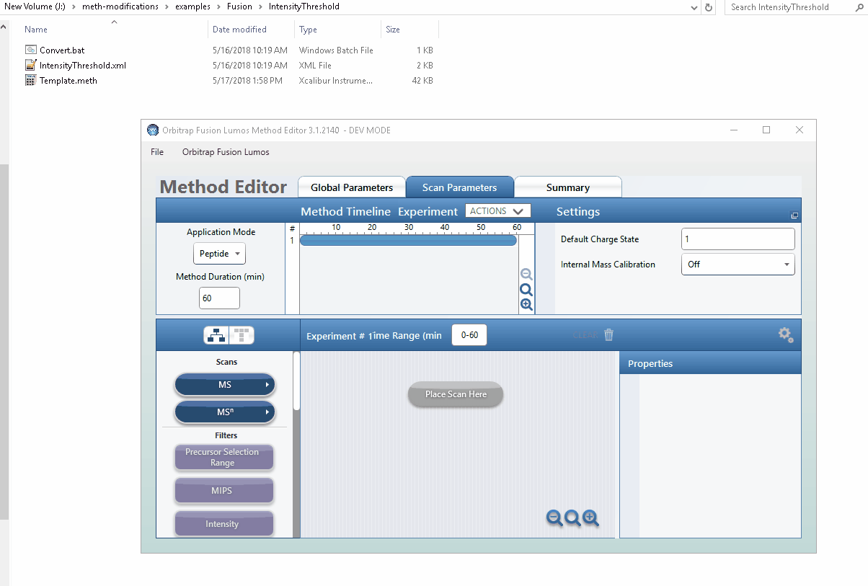
Demonstration
This example is from the examples/Fusion/IntensityThreshold/ directory in the Git repository

Slide 67
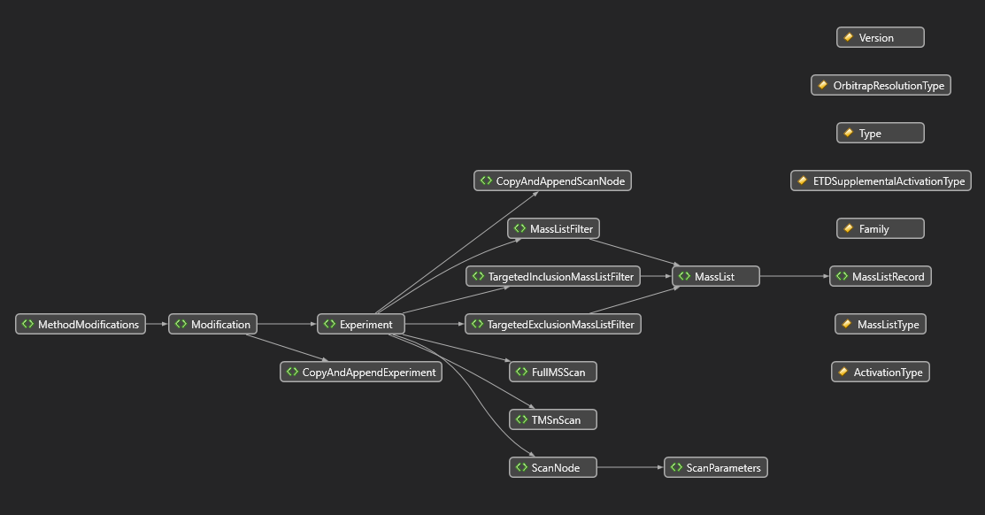
Fusion 3.1 Method Modification Schema
3.1/MethodModification.xsd

Slide 68
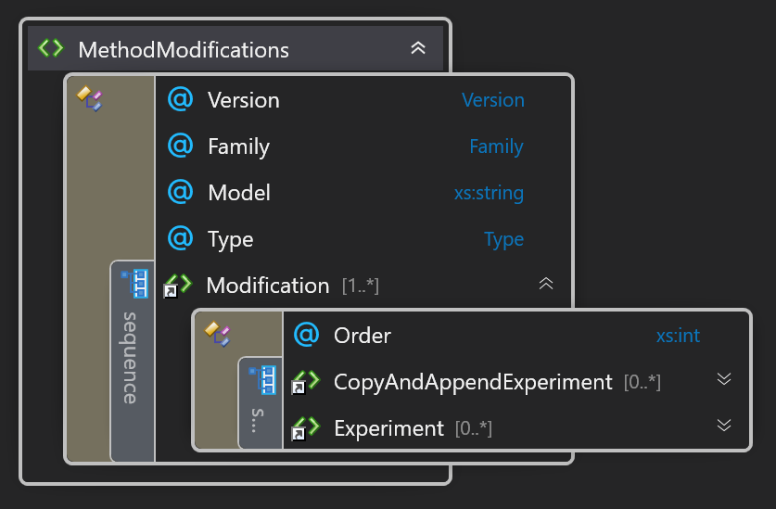
Method Modifications
The XML contains a collection of Modifications
Each Modification contains:
An Order attribute
This is the order that this modification will take effect, from low to high.
Collection of Actions elements
This is what the Modification performs on the method
Experiments are performed first, in the order they are defined in the xml
CopyAndAppendExperiment are performed second, in the order they are defined in the xml

Slide 69
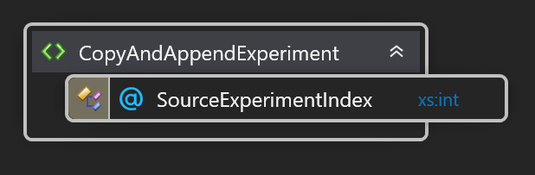
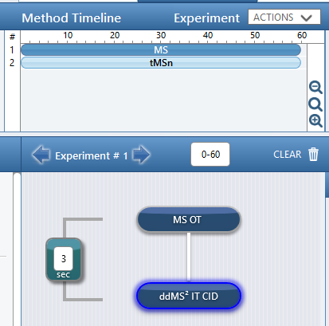
Copy And Append Experiment
Copies a method experiment and appends it the end of all the experiments
The attribute SourceExperimentIndex (0-based) specifies which experiment to copy

Slide 70
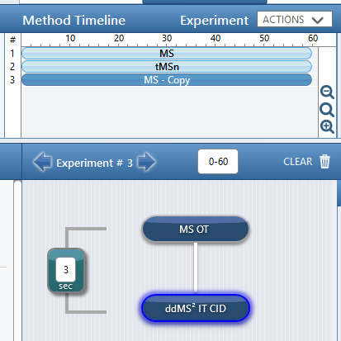
Copy And Append Experiment
Copies a method experiment and appends it the end of all the experiments
The attribute SourceExperimentIndex (0-based) specifies which experiment to copy

Slide 71

Experiment Modifications
Modifies an experiment based on the attribute ExperimentIndex (0-based)
Here you can target certain nodes/filters of the selected experiment and modify their contents
You can also modify the experiment time frame with the StartTimeMin and EndTimeMin fields.

Slide 72

Source Node Position
SourceNodePosition is a mechanism to specify a specific node in scan tree

Slide 73
Source Node Position
SourceNodePosition is a mechanism to specify a specific node in scan tree
Each instance of SourceNodePosition selects which child node to select; numbered left-to-right and 0-based.
0
1
0
1

Slide 74

Source Node Position
SourceNodePosition is a mechanism to specify a specific node in scan tree
Each instance of SourceNodePosition selects which child node to select; numbered left-to-right and 0-based.
To specify the highlighted node, you would need to do:
0
1
0
1

Slide 75
Source Node Position
SourceNodePosition is a mechanism to specify a specific node in scan tree
Each instance of SourceNodePosition selects which child node to select; numbered left-to-right and 0-based.
To specify the highlighted node, you would need to do:
The first instance selects the left branch off the MS1.
0
1
0
1

Slide 76
Source Node Position
SourceNodePosition is a mechanism to specify a specific node in scan tree
Each instance of SourceNodePosition selects which child node to select; numbered left-to-right and 0-based.
To specify the highlighted node, you would need to do:
The first instance selects the left branch off the MS1.
The second instance selects the right branch off the ddMS2
0
1
0
1

Slide 77

Copy And Append Scan Node
Copies a scan node in the experiment and appends it to its parent node
Uses SourceNodePosition to specify the specific node in the tree

Slide 78


Copy And Append Scan Node
Copies a scan node in the experiment and appends it to its parent node
Uses SourceNodePosition to specify the specific node in the tree

Slide 79

Scan Node Modification
Modifies a scan based on the specified SourceNodePosition.
You can currently change the
Isolation offset
CID Collision Energy
HCD Collision Energy

Slide 80



Mass List Filter Modification
Modifies a filter with a mass list based on the specified SourceNodePosition and Above attribute
To specify the filter, you first select the node the filter is attached to, and then indicate if the filter is above or below the node.
This filter would be defined as

Slide 81

Mass Filter Modification
Modifies a filter with a mass list based on the specified SourceNodePosition and Above attribute
To specify the filter, you first select the node the filter is attached to, and then indicate if the filter is above or below the node.
This filter would be defined as
And this filter would be defined as

Slide 82


Mass List Modification
MassList contains a collection of MassListRecords which are the entries in the table
The different Boolean attributes control which columns in the table are used
The Append attribute indicates if the entries are append to the list or are overwritten

Slide 83
Overview
Instrument Application Programming Interface (IAPI)
Real-time control and acquisition of Orbitrap Mass Spectrometers using .NET
XML Method Modification Interface (XMMI)
Programmatically modify Fusion-series method files
Applications of IAPI
Devin Schweppe – Fusion API
Christoph Wichmann – Q Exactive API
Examples and FAQ for IAPI and XMMI
Applications of XMMI
Pavel Shliaha – Fusion Method Creation

Slide 84
Overview
Instrument Application Programming Interface (IAPI)
Real-time control and acquisition of Orbitrap Mass Spectrometers using .NET
XML Method Modification Interface (XMMI)
Programmatically modify Fusion-series method files
Applications of IAPI
Devin Schweppe – Fusion API
Christoph Wichmann – Q Exactive API
Examples and FAQ for IAPI and XMMI
Applications of XMMI
Pavel Shliaha – Fusion Method Creation

Slide 85
IAPI FAQ
Is the IAPI Free?
Yes! Though it requires a license agreement with Thermo.
Are the Q Exactive and Fusion IAPIs the same?
They are not binary compatible, but share the same structure, namespacing, and basic data and control paths.
It only requires a minimal amount of work to convert code between the two APIs.
How do we obtain the IAPI?
Interfaces are shared on https://github.com/thermofisherlsms/iapi
Contact ThermoMSLicensing@thermo.com to start the process.
Can you run the IAPI while acquiring an acquisition from a method?
Yes, the IAPI works even when in idle, or actively running a method.

Slide 86
IAPI FAQ
Are IAPI scans parallelized?
When running a method, IAPI scans are inserted into the acquisition pipeline that parallelizes the scans with other scans.
When running without a method, IAPI scans are not parallelized.
Are the results of the method filters published through the IAPI?
The IAPI only publishes the raw spectrum, without any of the method filters taking effect.
Can we obtain profile data through the IAPI?
Currently only the centroided data is returned to the IAPI.
Is the IAPI 64-bit enabled?
No, the main instrument service is a 32-bit service and cannot export a 64-bit interface

Slide 87
XMMI FAQ
Can you modify every parameter?
No, only a subset of parameters in a method can be modified using this API.
I want to modify parameter X, Y and Z, can you provide it?
Please file an issue with the github account describing the desired changes.
https://github.com/thermofisherlsms/meth-modifications/issues
Do you need be attached to an instrument to modify methods?
No, if you have installed the Workstation configuration, you can create and modify methods on any computer.
Does this work for Exactive methods?
This interface does not currently support Exactive method modification.

Slide 88

IAPI Example – Tribrid Series
Use Thermo.TNG.Factory.Factory.Create() to create instrument access container
Connect to the main service using the StartOnlineAccess() call
Wait until server has connected and get access to a particular instrument
This example is from the examples/tribrid/MinifiedExample/ directory in the Git repository

Slide 89
Overview
Instrument Application Programming Interface (IAPI)
Real-time control and acquisition of Orbitrap Mass Spectrometers using .NET
XML Method Modification Interface (XMMI)
Programmatically modify Fusion-series method files
Applications of IAPI
Devin Schweppe – Fusion API
Christoph Wichmann – Q Exactive API
Examples and FAQ for IAPI and XMMI
Applications of XMMI
Pavel Shliaha – Fusion Method Creation

Slide 90


Controlling the Syringe from the IAPI
The ISyringePumpControl interface enables direct control of the syringe

